Slide 1

Efficacy of a Pressure-Sensitive mat within the PANDA Gym in Assessing Developmental Delays in Infants
Susan Zhao
Dr. Michelle J. Johnson, Mayumi Mohan
LSAMP Summer 2017
Notes:
Hello, my name is Susan and this summer I had the opportunity to work in the Rehabilitation Robotics Lab under the supervision of Dr. Michelle Johnson, and the additional guidance of my mentor Mayumi (who is here and is the best mentor in the world). My project is the Efficacy of a Pressure-Sensitive Mat within the PANDA Gym in Assessing Developmental Delays in Infants.

Slide 2


Why STEM?
Choosing Robotics
Notes:
What brought me to Rehab Lab was my interest in robotics. This is an interest that was inspired by my dad’s own personal enthusiasm towards technology. He’s passionate about exoskeletons, prosthetics, and healthcare/home robots. His childhood polio has left him handicapped, but despite that he is optimistic towards the future with the constant improvement of healthcare technoloty. So while I’ve chosen robotics for many reasons, there’s still that small part of me that’s excited I can create something really impactful and positive towards his life and his health. While I haven’t done that just yet, this summer I’ve had a chance to work on a project that impacts others…

Slide 3
The Problem
Cerebral Palsy is the most common childhood disability
2.3 cases per every 1000 children^{[1]}
41.5% of CP diagnoses are preterm infants^{[1]}
Current assessment occur late in infancy
Subjective tests
Qualitative measures
[1]Leonard, C., R. Piecuch, and B. Cooper. 2001. “Use of the Bayley Infant Neurodevelopmental Screener with Low Birth Weight Infants.” Journal of Pediatric Psychology. 26 (1): 33-40.
Notes:
Those are children. Cerebral Palsy is the most common childhood disability, affecting 2 to 3 out of every 1000 infants born in the US. The risk of cerebral palsy is greatly increased in preterm infants -41.5% of diagnoses are preterm infants. While there exists assessments to diagnose infants, these tests are only at its most stable and accurate when infants are around 2 years of age. Earlier detection would allow for treatment when a child has the greatest potential for neuroplastic change. In addition, these tests such as the Bayley’s Infant Neurodevelopment screener relies on very subjective tests and has only been proven to be 60% accurate.

Slide 4
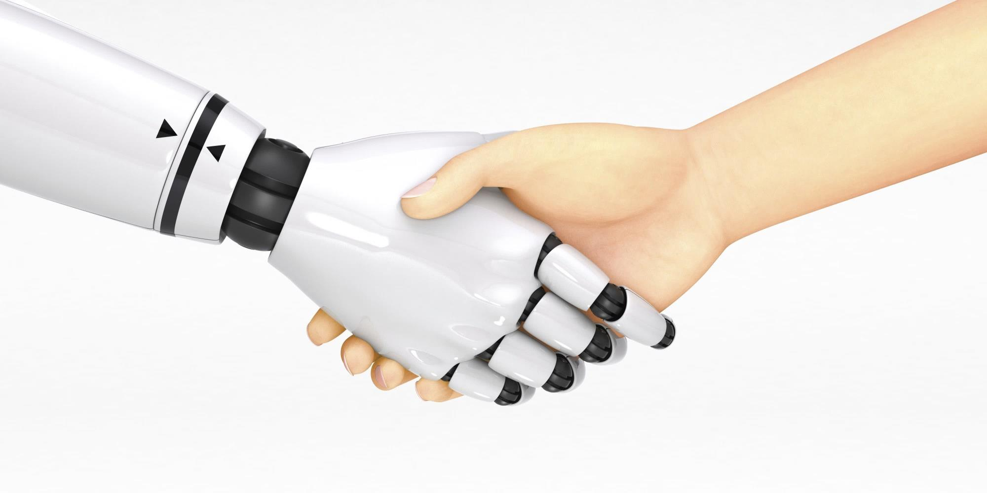

The Solution
Play
A nd
Neuro-
Development
A ssessment
Early diagnosis
Quantitative Data
Natural play environment
Notes:
Our solution is the Play and Neuro-development assessment gym, or PANDA gym. The PANDA gym is a system specifically designed to aid in early diagnosis and to provide quantifiable measures. It is a natural play environment that analyzes infant movement as he or she interacts both with and without toys. This provides a new frame of assessing atypical infant motor development, filling the existing gap of quantitative metrics for analysis. This would eliminate the necessity of having trained professionals be on site for each testing procedure, as we hope to create a system that is easy to use. Conducting tests this way would be more cost-effective…

Slide 5
Design
Design
Notes:
ANIMATE!
Have the video first, and then include diagrams and pictures
Representative video
How the system is used in terms of experimentation
Slide that breaks down the systems, how it works

Slide 6

Summer Objectives
Run clinical trials
Analyze Data
Assess and Redesign system

Slide 7
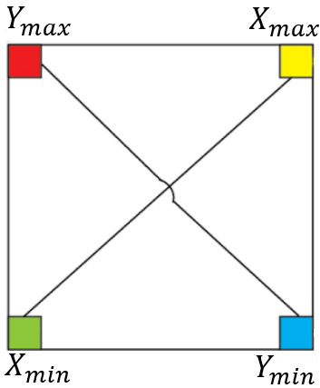

Trials
Baby positioned with head towards RY side
Two force sensors create an axis

Slide 8
Subjects
Fullterm: < 6 months, > 6 months
Preterm
Conditions
No Toy
Toy
Notes:
How experiments are conducted (what conditions)
Where you’re getting your data

Slide 9
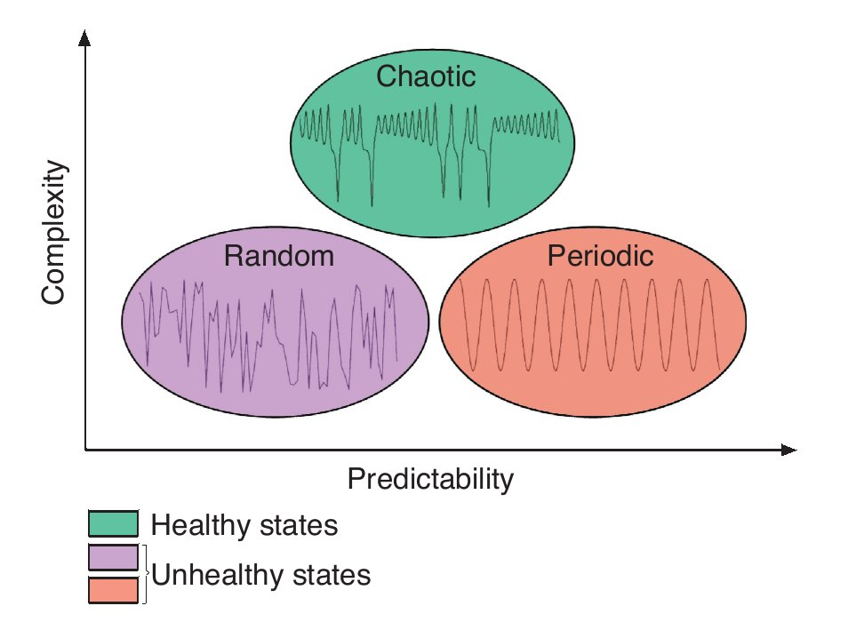
Metrics
-Center of Pressure (CoP) Magnitude
-Approximate Entropy (ApEn)

Slide 10
Hypotheses
Range of movement decreases with age
Postural Control
CoP Magnitude decrease
Increase in complex behavior with addition of toy
Exploratory Movement
ApEn increase
Preterm infants exhibit more predictable movements
Postural Control
ApEn decrease
Notes:
There are three key hypotheses for this study. We predict that the range of movement decreases with age. This is a prediction associated with postural control, where older infants will have greater postural control and move with less extraneous movements. We also predict an increase in complex behavior with the addition of a toy. This is associated with exploratory movement, since a child will be introduced to a new toy and begin to interact with it, causing a change in behavior. Finally we predict preterm infants will exhibit more predictable movements. This is another association to postural control, where preterm infants have poor control and would thus have a sway or periodic rhythm to their movements.
Approximate entropy ApEn quantifies the complexity and predictability of the COP time series
When I saw the first baby at the NICU, I saw the potential impact of this system for these babies and their families
Running projects real-time, realized a lot of other necessary skills

Slide 11
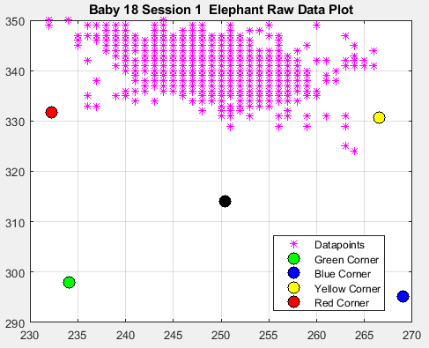
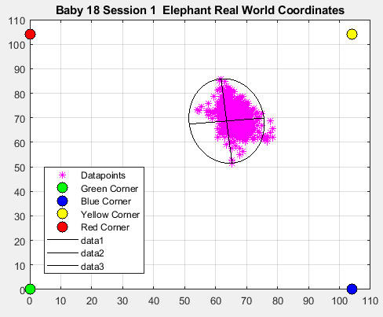
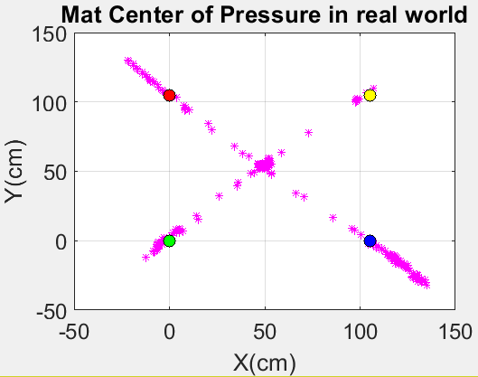
Data Processing
Raw Baby Data
Calibration Data
Raw Baby Data
Real-World Frame
Notes:
We begin data processing by mapping the data from the sensor frame to the world coordinate frame. Before each trial we collect a calibration test, and this defines the boundaries of our system. We use this calibration data to map the raw data to what you see on the right. This is representative of where the baby actually was on the mat and how it moved in real life testing.

Slide 12
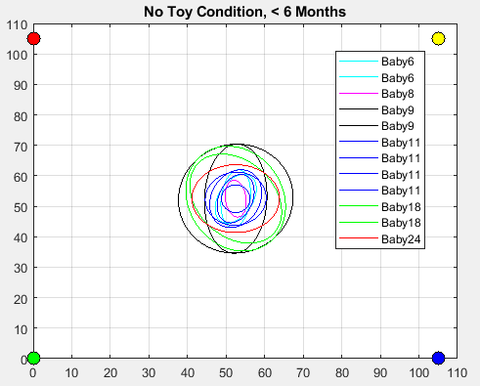


Data Analysis
Notes:
We tested 3 preterm and 9 fullterm babies. We fit an ellipse to represent the CoP magnitude of each baby, then overlaid the ellipse plots to obtain a comparison between the movement of the babies. We had a LOT of data, which was very challenging to analyze. But, after going through the data, we found these trends.

Slide 13
Trends
CoP Magnitude
Fullterm >6mo
Fullterm <6mo
Preterm
No Toy Condition
Preterm
Fullterm <6mo
Fullterm >6mo
Toy Condition
Approximate Entropy
Fullterm <6mo
Fullterm >6mo
Preterm
Both Conditions
Notes:
The first trend is the No Toy Condition. The preterm babies had the greatest movement in that category, but the ordering is reversed in the toy condition. The ApEn results were the most surprising, seeing as the preterm babies exhibited the most complex behavior in their movements. With these trends, we draw conclusions.

Slide 14
Conclusion
Range of movement decreases with age
Showcased in No Toy condition, not Toy condition
Increase in complex behavior with addition of toy
Inconsistent across age groups
Preterm infants exhibit more predictable movements
Preterm infants exhibited greatest complexity
Notes:
Our first hypothesis: range of movement decreases with age, was showcased in the No Toy condition but not with the addition of a toy. A possible explanation for this result is the onset of grabbing and reaching. It is possible that older babies have the ability to grasp and interact with the toy more, resulting in greater movement. For our hypothesis that there will be an increase in complex behavior with the addition of a toy, our data results were inconsistent with our hypothesis. Complex behavior increased for all groups except for the oldest age group. More surprisingly of all, preterm infants exhibited greatest complexity in our study, a total opposite of our hypothesis. As this was a pilot study we were still able to view some general trends. But in the future we hope to test more babies and collect more data in longitudinal studies before generating more concrete results.

Slide 15
Areas for Improvement
Stability
Shakiness of structure
Transportation of load cells
Springy-ness of the mat
Precision/Accuracy
Nonlinearity in force sensors and signal processors
Max Weight capacity
Notes:
My third task was the assess and redesign the mat system. I plan to improve the stability, precision and accuracy of the mat. This summer I conducted many experiments on the mat that allowed me to determine sources of error. There is shakiness in the structure when the baby plays with the toys, the effect of transporting load cells not manufactured to be portable, and the springy-ness of the mat that greatly affects the stability of our readings. Both precision and accuracy is affected by the nonlinearity in force sensors and signal processors and the max weight capacity.

Slide 16
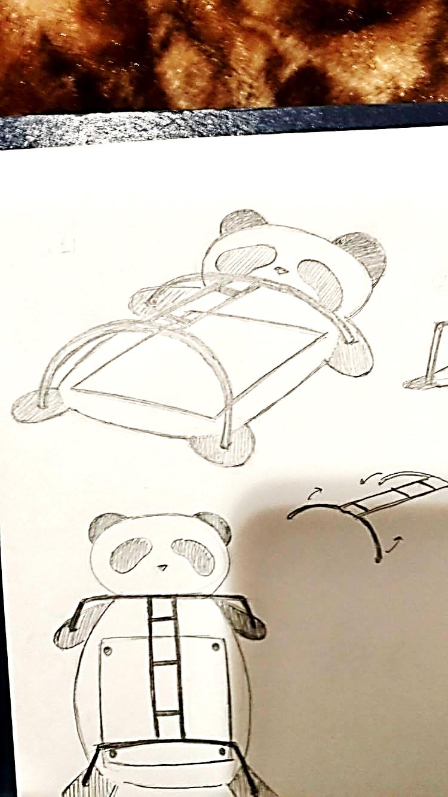
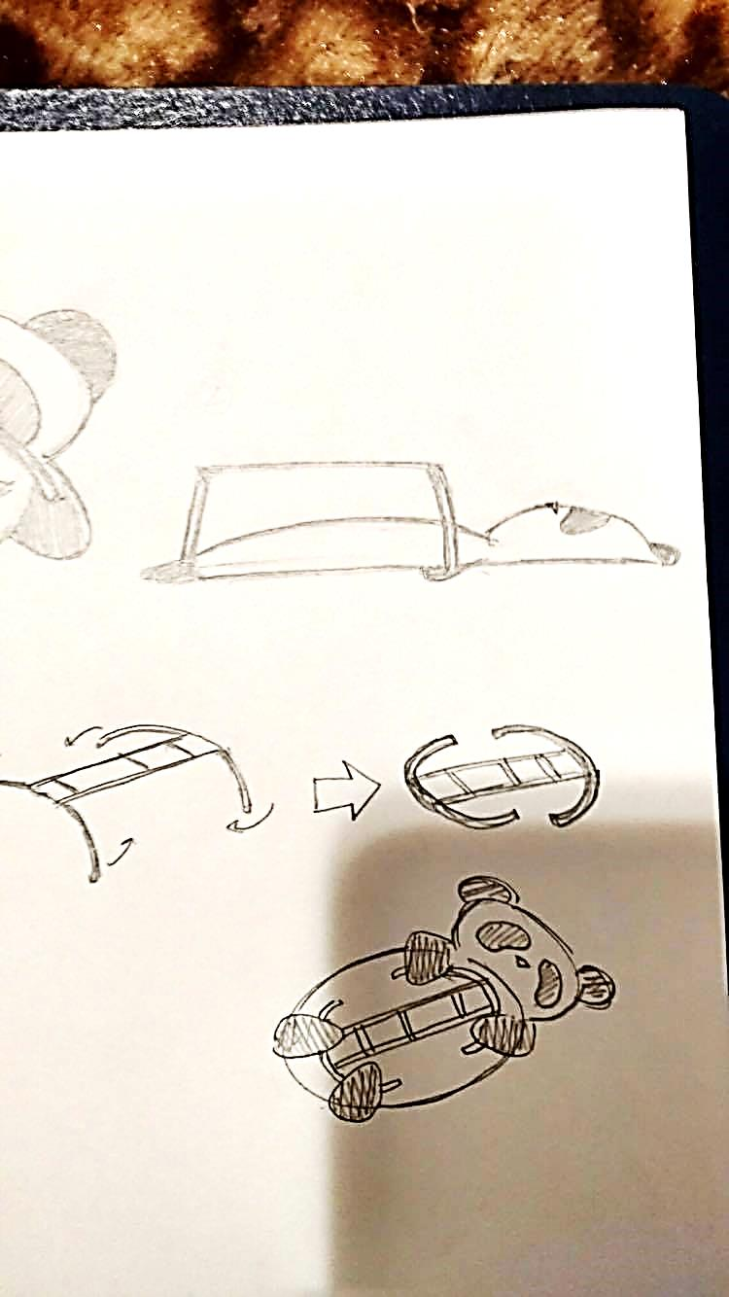
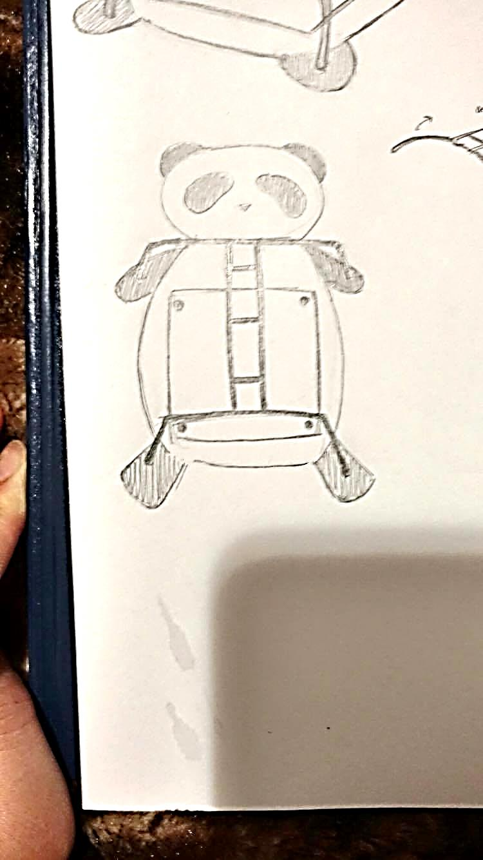
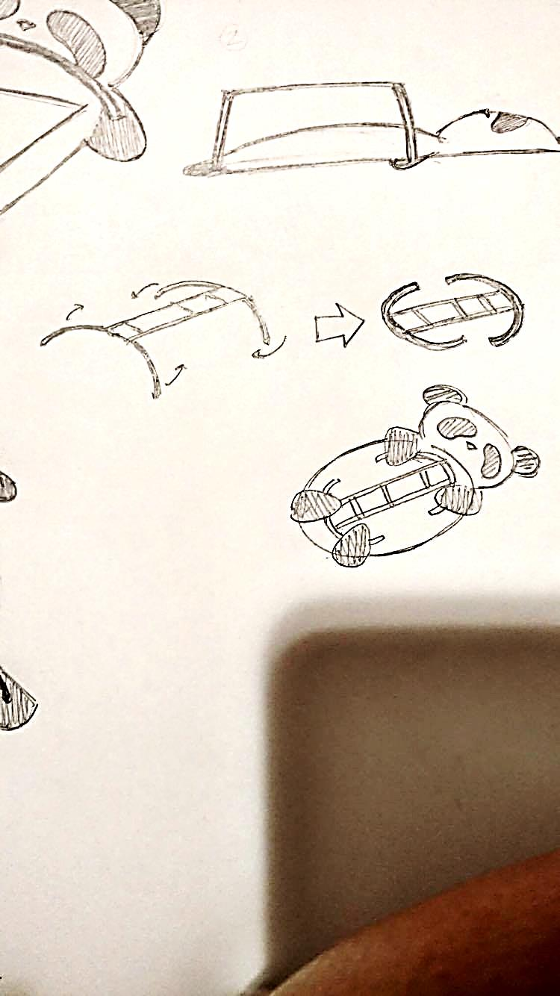
Mat Redesign
Overhanging structure
Plush!
Pressure-Sensitive Mat
Collapsibility
Force sensors
Portability
Notes:
If you haven’t already gotten tired of this joke, this is my PANDA redesign with – a panda. This is a plush panda surrounding a smaller pressure-sensitive mat, as our current system is large and unwieldy. The force sensors are embedded into the mat itself, reducing damage to them. The overhanging structure both minimal, curved to look friendly, and is collapsible.

Slide 17
Lessons Learned
Clinical Testing
Neonatal Intensive Care Unit (NICU): Potential of our system
Data Analysis
Overcome challenges
Assessment and Redesign
Gain full understanding of the mat system
Understand shortcomings of the mat and design to reduce error in measurements
Notes:
There are my main takeaways for this summer. The most memorable moment was when I performed clinical testing at the NICU. These babies were swathed in wires and hooked to all the machines monitoring their vitals. This was when I saw the true potential in our system in giving early diagnoses to these infants, allowing them to have the best rehabilitative treatment as early as possible and really reducing the worry and pain of the family as a whole. Data analysis was challenging –so a major hurdle was persevering and just continuing to debug and process the data. My third task allowed me to gain a full understanding of the current mat system with all its flaws and plan for the future to reduce error in measurements.

Slide 18


&

Slide 19



There is no substitute for hard work
-Thomas A. Edison
Notes:
A lot of ups and downs with processing data,
And how STEM doesn’t necessarily make our lives easier, but it gives us the power to make other’s lives better
When my project got difficult, led me to problems I didn’t expect, it doesn’t mean that it’s time to give up (THEN MONTAGE OF THINGS FOR FUTURE WORKS)
Father did not have a choice
I have the luxury of having a choice, and the only obstacle is my own ambition
Then thank LSAMP, blah blah

Slide 20
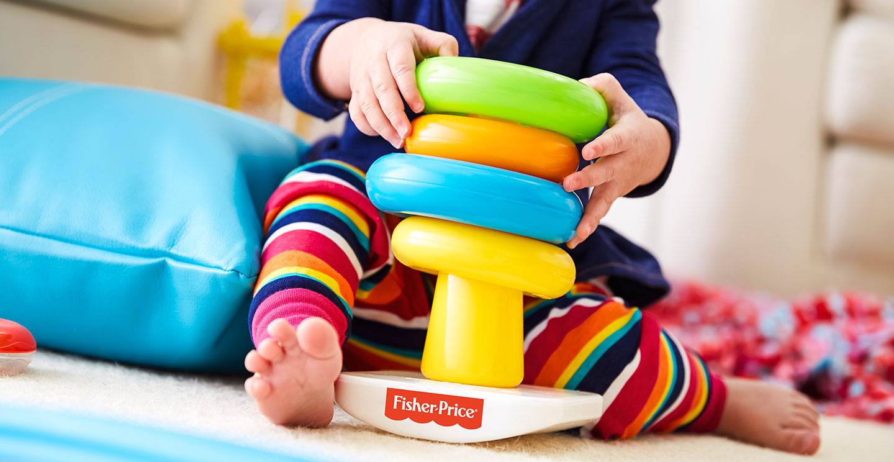
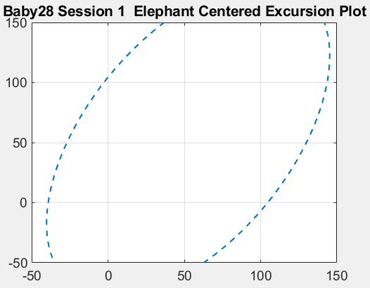
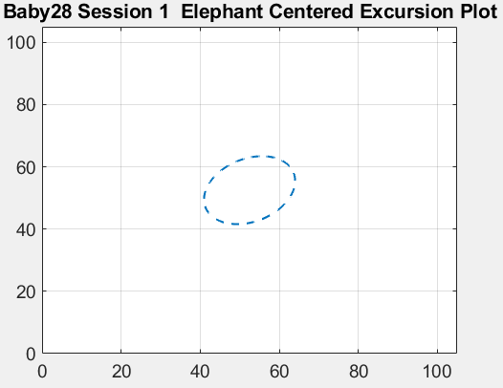
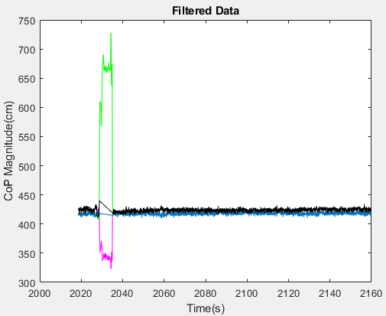
Future Plans
Data Processing
Filtering
Videos: Verify/compare movement for remaining babies
Redesign of mat system
Green/Pink: Unfiltered
Black/Blue: Filtered
Notes:
Have a solidworks video of redesign construction

Slide 21
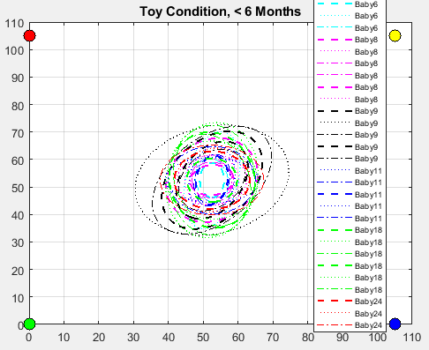
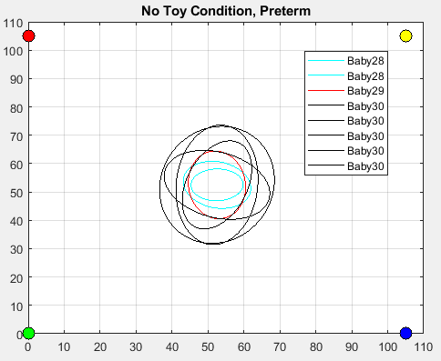
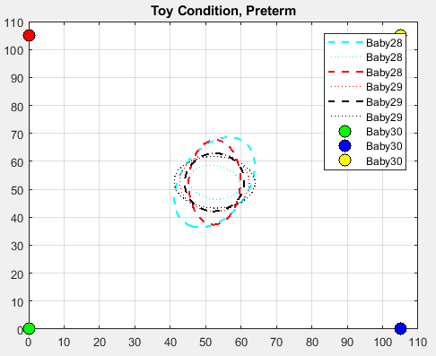
Results
Notes:
Could use work on improved system: encoder –say all your points at once!
BIGGER PICTURES
A weird transition from the graph to the noise slide, should predict that slide is next

Slide 22
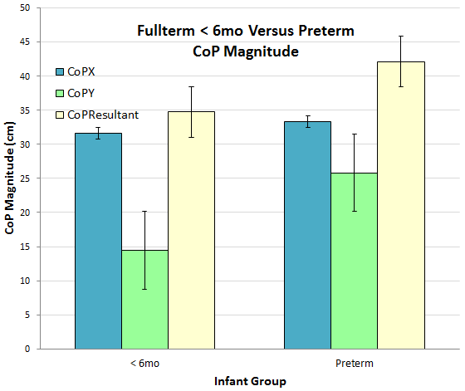
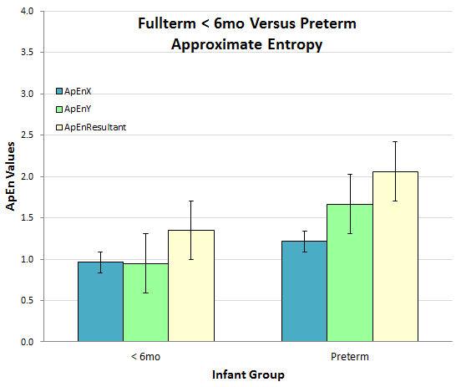
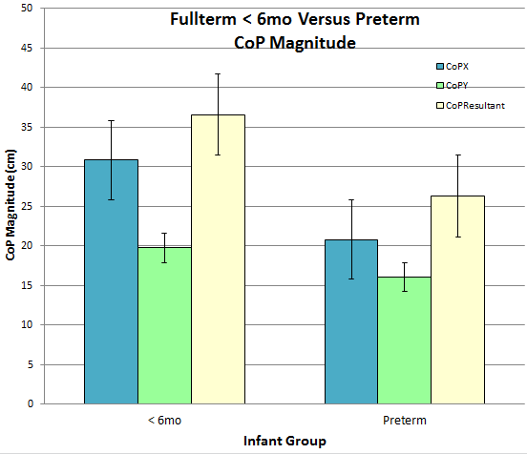
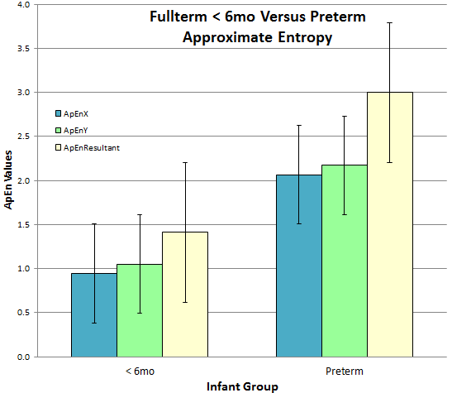
No Toy Condition
Toy Condition
 | CoPX | CoPY | CoPResultant
< 6mo | 31.60 | 14.43 | 34.74
Preterm | 33.31 | 25.82 | 42.14
 | 1.71 | 11.39 | 7.41
 | CoPX | CoPY | CoPResultant
< 6mo | 30.81 | 19.73 | 36.58
Preterm | 20.79 | 16.05 | 26.27
 | 10.02 | 3.68 | 10.32
 | ApEnX | ApEnY | ApEnResultant
< 6mo | 0.94 | 1.05 | 1.41
Preterm | 2.07 | 2.17 | 3.00
 | 1.12 | 1.12 | 1.58
 | ApEnX | ApEnY | ApEnResultant
< 6mo | 0.96 | 0.95 | 1.35
Preterm | 1.21 | 1.67 | 2.06
 | 0.25 | 0.72 | 0.71
Notes:
Place one at a time
All the y axes should be the same
No Toy Condition ApEn is same as Toy??? Check the data you put in
Standard error bars, takes into account the number of trials in each group

Slide 23
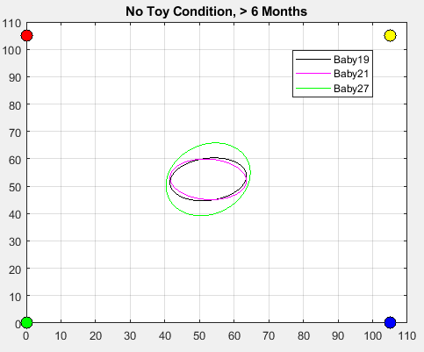
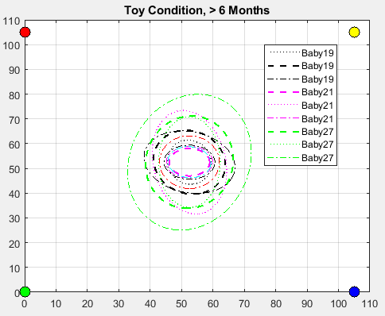
Fullterm <6 months vs >6 months
Notes:
Reveal by age group

Slide 24
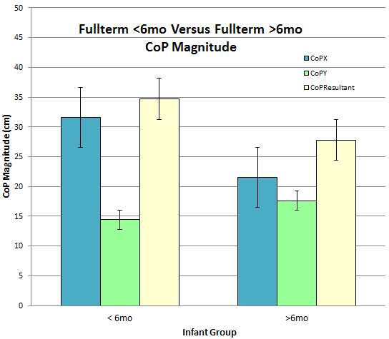
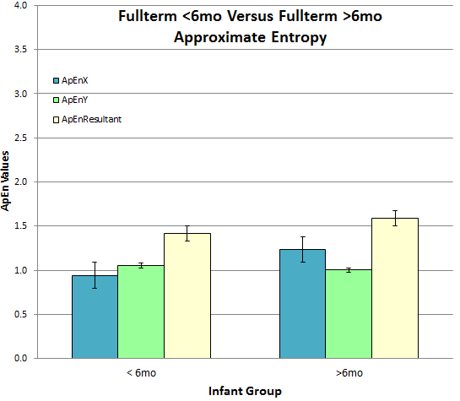
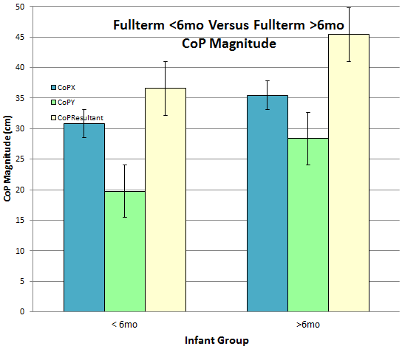
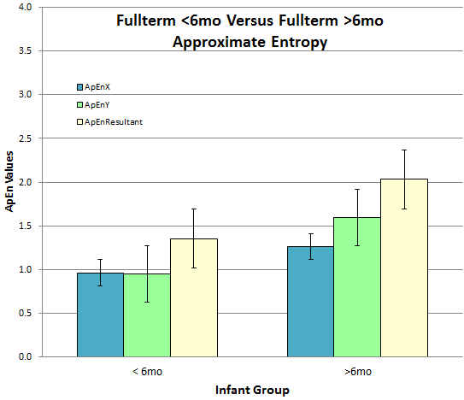
Toy Condition
No Toy Condition
 | CoPX | CoPY | CoPResultant
< 6mo | 30.81 | 19.73 | 36.58
>6mo | 35.47 | 28.36 | 45.42
 | 4.67 | 8.63 | 8.83
 | CoPX | CoPY | CoPResultant
< 6mo | 31.60 | 14.43 | 34.74
>6mo | 21.51 | 17.63 | 27.81
 | 10.09 | 3.20 | 6.93
 | ApEnX | ApEnY | ApEnResultant
< 6mo | 0.96 | 0.95 | 1.35
>6mo | 1.26 | 1.59 | 2.03
 | 0.30 | 0.64 | 0.68
 | ApEnX | ApEnY | ApEnResultant
< 6mo | 0.94 | 1.05 | 1.41
>6mo | 1.23 | 1.00 | 1.59
 | 0.29 | 0.05 | 0.18
Notes:
Present one at a time
Conclusion slide

